Slide 1


Major project stage - 1 on vehicular accident detection and alert generation using IOT
d. Jyothi (22x05a0412)
Ch. Sai Sri (21x01a0414) under the guidance of
o.g.naga sai (21x01a0436) Mrs. sujana
a.Lakshman (21x01a0402) associate professor

Slide 2
ABSTRACT
Utilizing GSM and GPS, they pass on the messages to their family, relatives, or own people when a mishap is recognized or has happened. Suppose an individual is in a position where someone else is there to help, in that case, this venture assists with sending messages to their family members or companions and cautions the casualty's family or relatives. Accidents are on the ascent because of an increment in the number of vehicles out and about; we will most likely be unable to keep away from wounds, yet we can work salvage victims. Vehicle impact discovery is helpful in such circumstances. Mishap discovery utilizing shrewd GPS programming and GSM, phones, portable applications and vehicular impromptu organizations are among the frameworks recommended by different analysts. A vibration sensor distinguishes a crash utilizing piezoelectric impact, which is the measurement of specific products to produce an electric charge when these are under mechanical pressure.

Slide 3
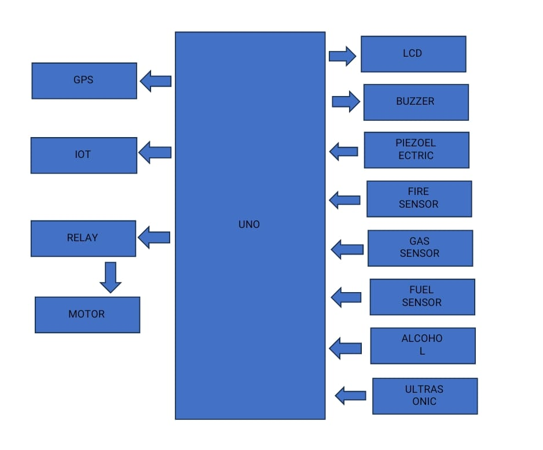
BLOCK DIAGRAM

Slide 4
PROPOSED SYSTEM
When accident occur pezio sensor activates then GPS takes the longitude and latitude value of the location and gives to the controller. Controller gives the information through GSM with a sms. Every so often while happenings accident the motor vehicle collision with another vehicle and the vehicle goes away without stopping vehicle. To overthrow this imperfection we proposed the new approach in the accident diagnosis and safe the system. By this approach the urgent situation will be efficiently used while in the road accidents. The device sensor ridicules driving can be noticed. Because of evolution in methodology technique, there is requirement for the recognition of exact motor vehicle exact positioned, right data transfer facilities freedom to motoring the software. Sometimes during accident the vehicle hits the other vehicle and it passes away without stopping.

Slide 5
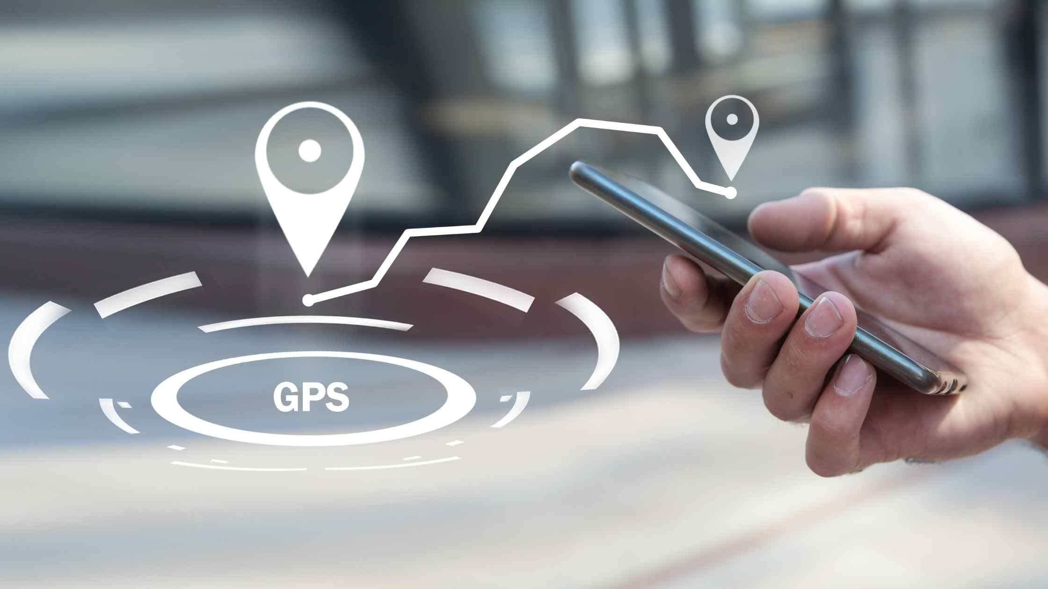
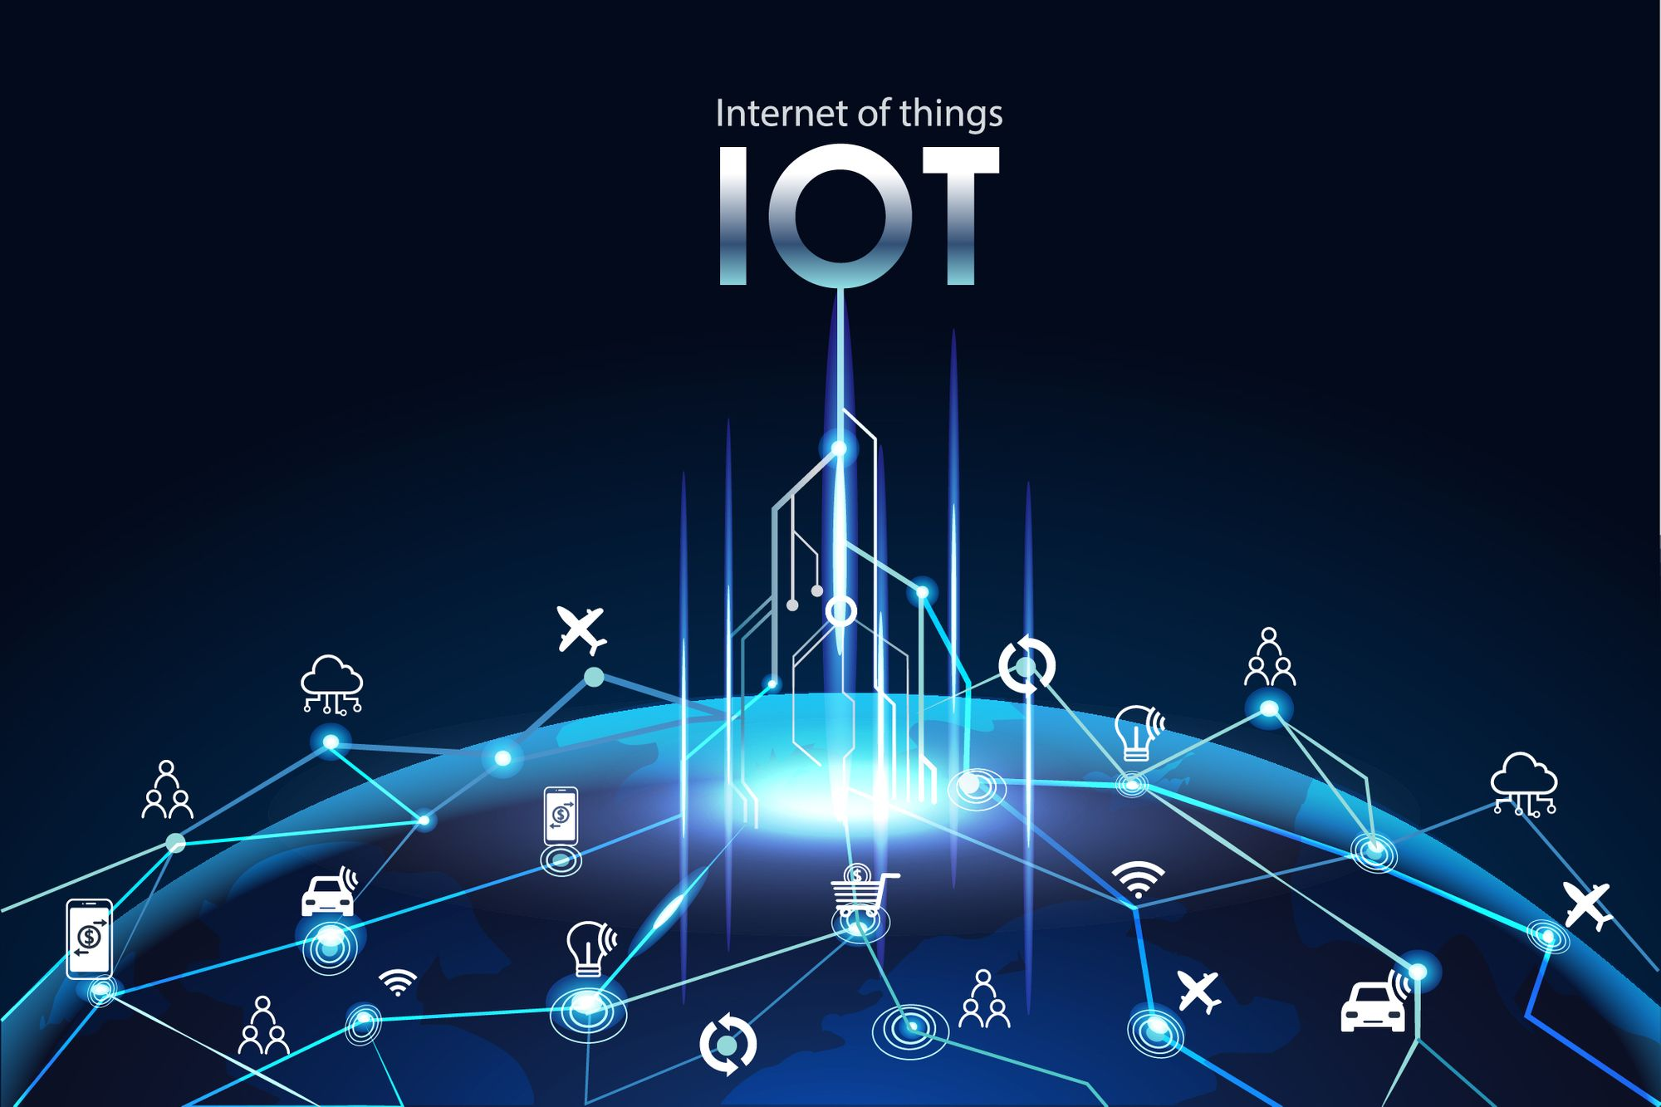
EXPLANATION
GPS : the global positioning system (GPS) is a u.s –owned utility that provides the users with positioning, navigation and timing (PNT) services.
IOT : the internet of things , refers to a network of interconnected devices that can collect , share, and act on data without requiring direct human intervention.

Slide 6
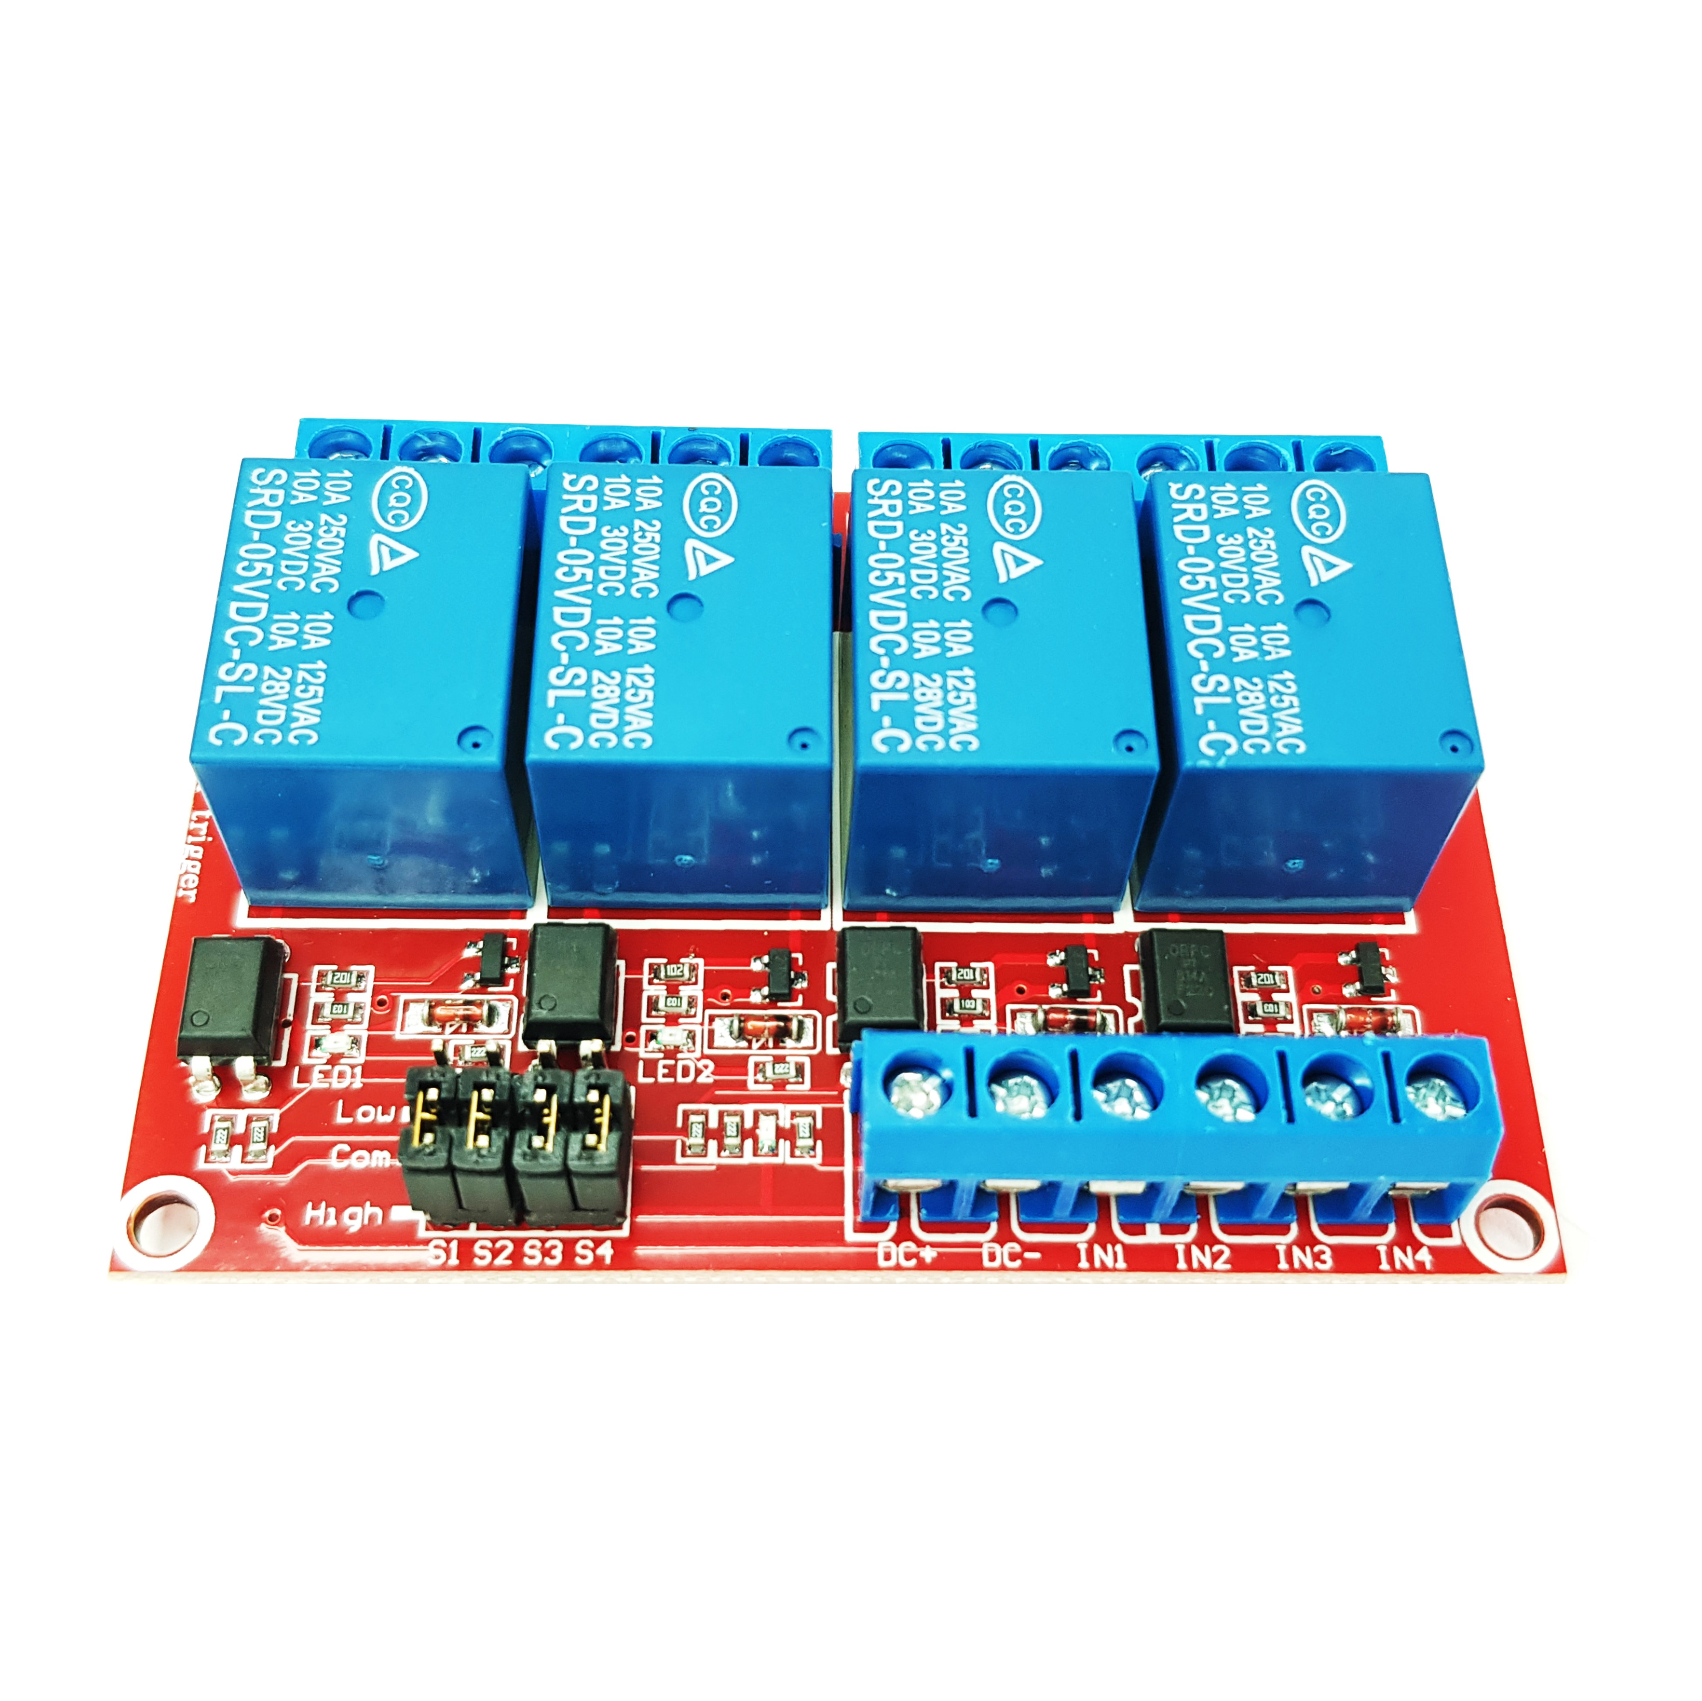
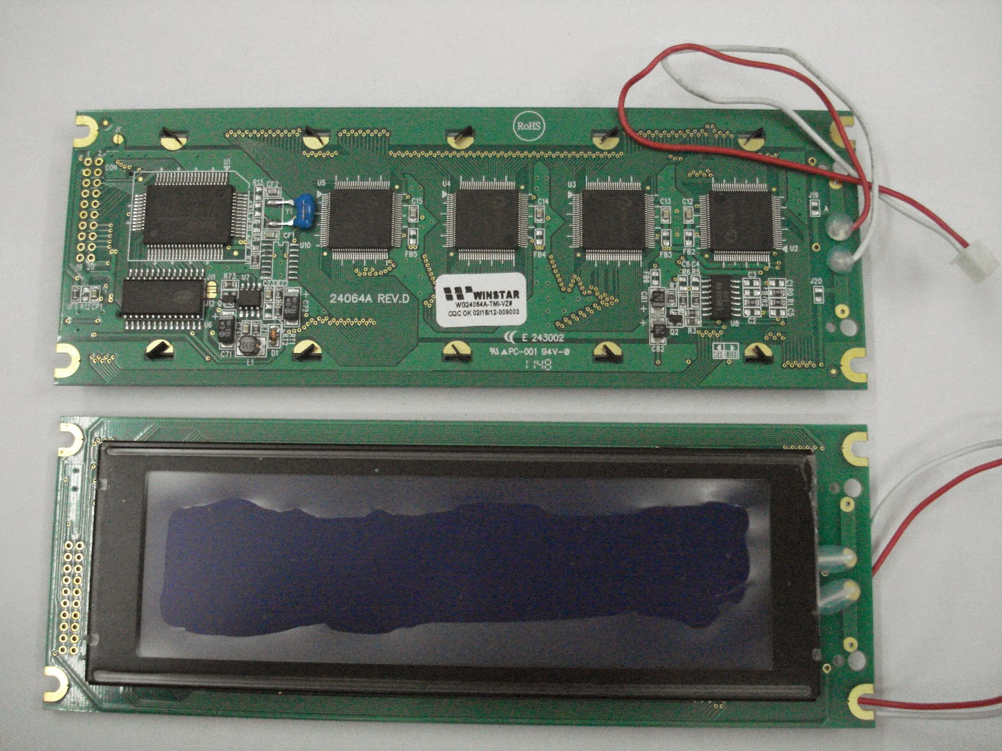
EXPLANATION
RELAY : A relay has a coil that, when energized with a small voltage, generates magnetic fields.
MOTOR : The output motor which is directly connected by serial to the relay , lcd & buzzer.
LCD : Liquid crystal display, is a flat-panel display technology commonly used in various applications, such as digital watches, calculators, televisions & computer monitors.

Slide 7
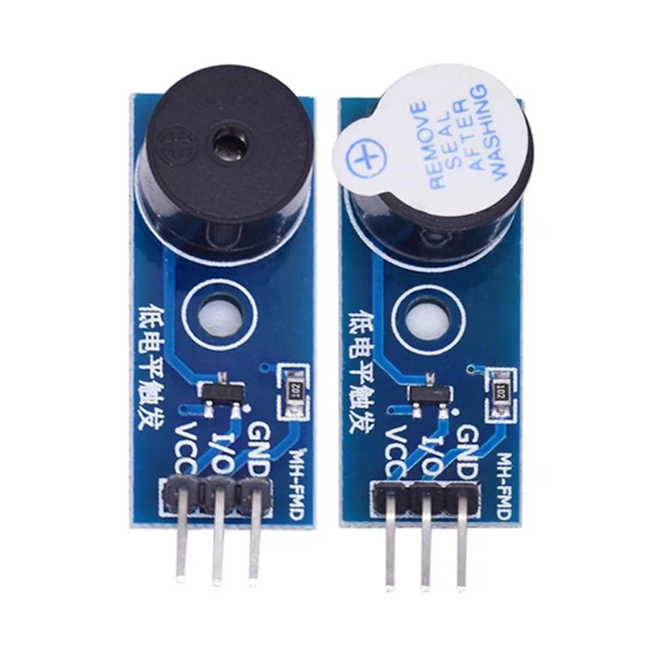
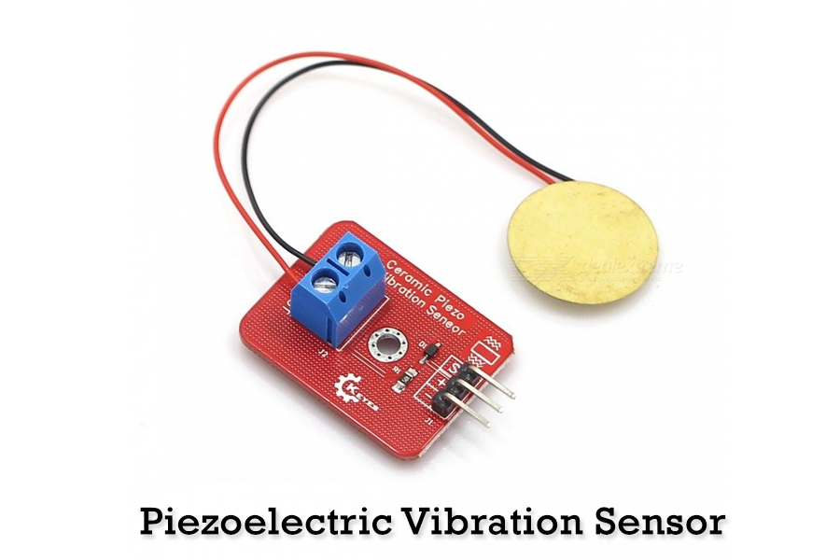
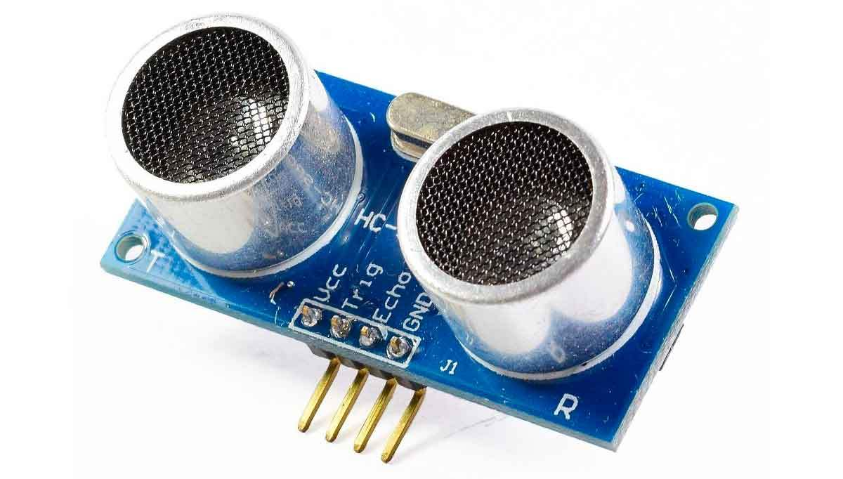
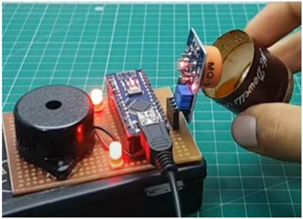
EXPLANATION
BUZZER : An electrical devices that makes a buzzing noise and is used for signal.
Piezoelectric : It is a device that uses the piezoelectric effect to measure
changes in pressure, acceleration, temperature by converting
them to an electrical charge.
Alcohol sensor : An alcohol sensor is a device designed to detect the presence
and concentration of alcohol vapours in the air, commonly use
in breathalysers and safety applications.
Ultrasonic sensor : An ultrasonic sensor is a device that uses ultrasonic waves to
measure distance or detect the presence of objects. It is widely
used in various applications, such as obstacle detection, level ,
measurement and ranging.

Slide 8
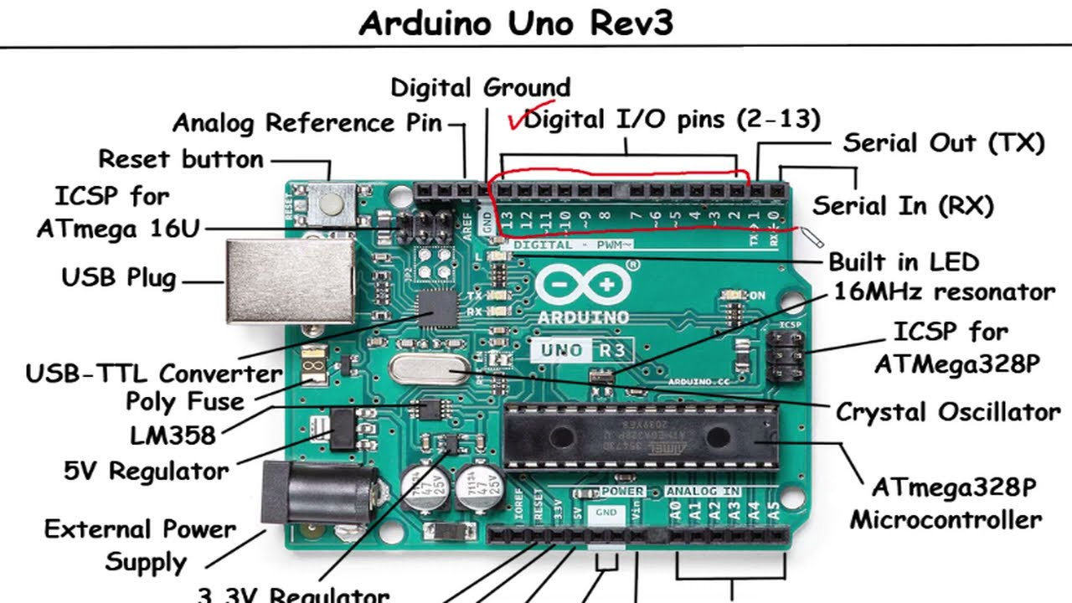
ARDUINO UNO
Arduino uno : The Arduino Uno is a popular microcontroller board from Arduino, ideal for beginners and experienced users alike due to its simplicity, versatility, and widespread community support. Here's a quick overview.

Slide 9
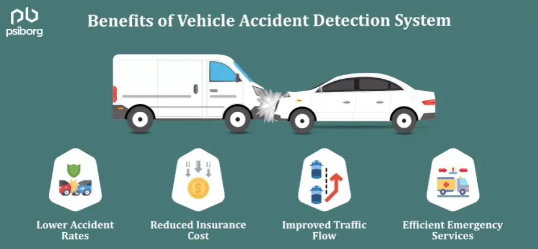
WORKING
Vehicular accident detection and alert generation using IoT relies on an integrated system of sensors, microcontrollers, and communication technologies to detect accidents in real time and immediately notify emergency services. Sensors such as accelerometers and gyroscopes monitor sudden changes in velocity or orientation, indicating a potential accident. Vibration sensors and airbag deployment detection also help confirm impact events. The data collected by these sensors is processed by an onboard microcontroller, which uses predefined thresholds or machine learning models to identify accidents.

Slide 10
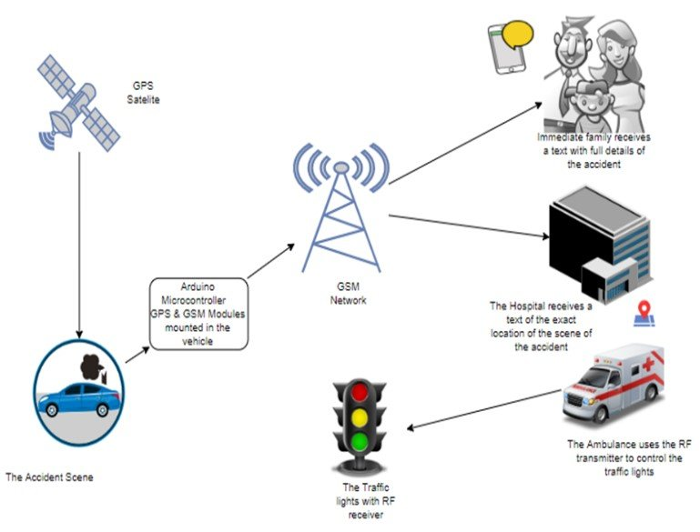
WORKING
Once an accident is confirmed, the system generates alerts, including the vehicle’s GPS location, and sends notifications to emergency contacts or directly to emergency responders. Cellular networks or low-power wide-area technologies like LoRa or NB-IoT are used for communication, ensuring that alerts are sent even in areas with limited connectivity. The system can also store data in the cloud for future analysis, assisting in insurance claims and safety improvements. This IoT-based approach enables faster response times, precise location reporting, and valuable data for enhancing vehicle safety systems.

Slide 11
THANK YOU

